Slide 1
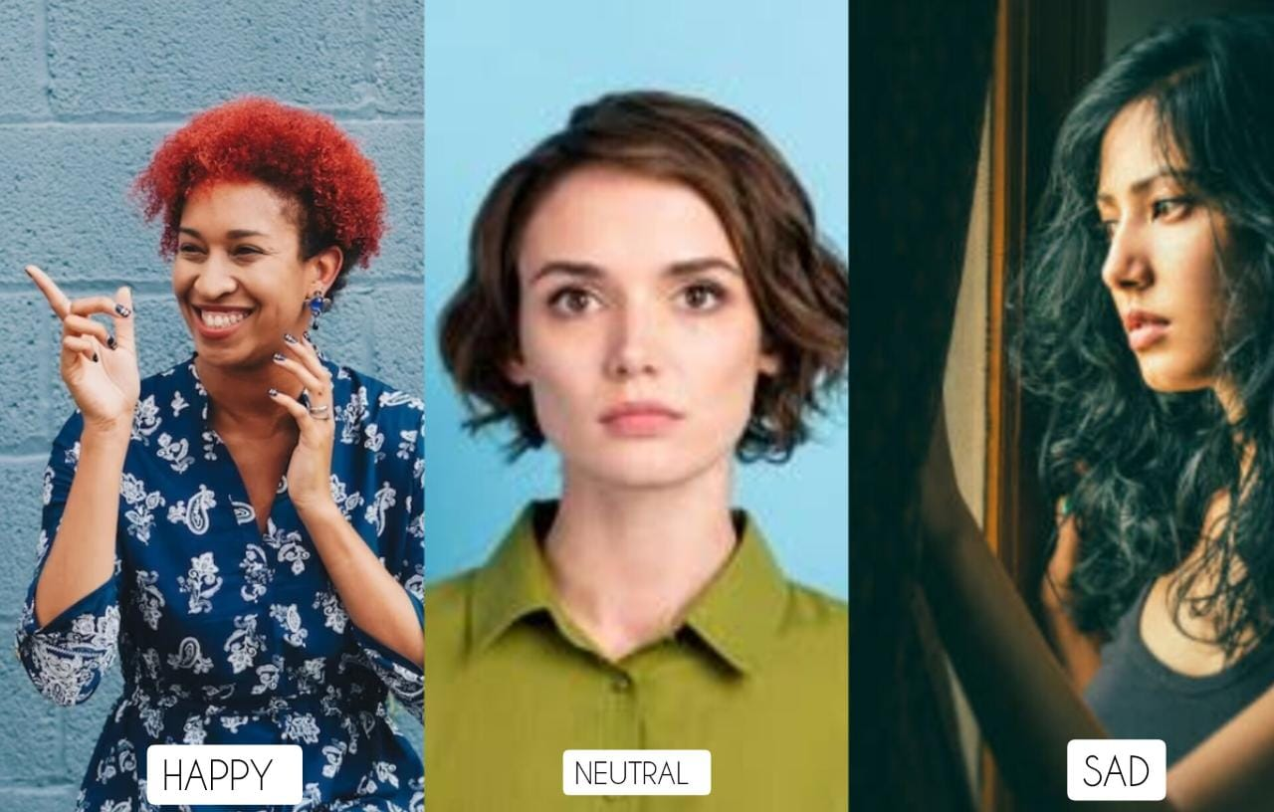
EmoCNN
UNLEASHING EMOTIONS
WITH CNN USING DIFFERENT OPTIMIZERS
Praneetha Umesh(1GA20CS100)
Sahana M(1GA20CS122)
Department of computer science and engineering
Global academy of technology, Bangalore

Slide 2
ABSTRACT
Human emotion detection from images is an essential task with numerous applications in fields such as psychology, human-computer interaction, and affective computing.
The proposed architecture utilizes the power of CNNs to automatically extract discriminative features from images, enabling the mapping of visual signs to specific emotional states. The CNN model architecture consists of convolutional layers, pooling layers, and fully connected layers, facilitating the learning of hierarchical representations that capture both local and global emotional patterns.
To enhance the performance of the emotion detection model, multiple optimizers are employed during the training process. Popular optimization algorithms, including Adam, RMSprop, and Adagrad are utilized and compared in terms of their impact on the accuracy of the CNN model.
The results highlight the influence of optimizer selection on the overall performance of the CNN model for human emotion detection. In addition, qualitative analysis is performed to visualize the learned features and gain insights into how the CNN, trained with different optimizers, captures and discriminates between various emotional states in human images.
The experimental findings indicate that the choice of optimizer significantly affects the accuracy and convergence speed of human emotion detection. Certain optimizers demonstrate superior performance, exhibiting faster convergence and higher accuracy compared to others
In conclusion, the results emphasize the importance of optimizer selection in achieving accurate and efficient human emotion recognition. This research contributes to the advancement of emotion detection techniques and provides valuable guidance for researchers and practitioners in the fields of computer vision, affective computing, and related disciplines.

Slide 3
KEYWORDS
Emotion Detection
Convolutional neural network(CNN)
Image Classification
Deep Learning
Optimizers
Model Optimisation
Performance Evaluation
Accuracy plot
Explainable AI(Xai)
Real Time Analysis

Slide 4
INTRODUCTION
Human emotion detection from images is a fascinating and challenging field that aims to automatically recognize and classify emotions portrayed by individuals based on their facial expressions.
It has wide-ranging applications in various domains, including human-computer interaction, mental health, market research, and entertainment.
Convolutional Neural Networks (CNNs), a powerful class of deep learning models, have demonstrated remarkable success in extracting meaningful features from images and achieving high accuracy in emotion detection tasks
.Optimizers play a crucial role in training CNN models for emotion detection. These algorithms determine how the network's parameters are updated during the learning process to minimize the loss function and improve performance. Different optimizers offer unique advantages in terms of convergence speed, robustness, and adaptability to different datasets.
In this field, researchers have explored various optimizers to enhance the performance of emotion detection CNN models.Adam is a popular optimizer, combines the benefits of adaptive learning rates and momentum, enabling efficient convergence and handling of sparse gradients.
RMSprop is an optimizer that adapts the learning rate based on the moving average of squared gradients, while Adagrad adapts the learning rate for each parameter based on its historical gradients. These optimizers, among others, have shown promising results in emotion detection tasks.

Slide 5
Adam, another popular optimizer, combines the benefits of adaptive learning rates and momentum, enabling efficient convergence and handling of sparse gradients.
RMSprop is an optimizer that adapts the learning rate based on the moving average of squared gradients, while Adagrad adapts the learning rate for each parameter based on its historical gradients. These optimizers, among others, have shown promising results in emotion detection tasks.
Moreover, researchers have leveraged statistical techniques and methodologies to improve the accuracy and robustness of emotion detection CNN models. They have explored techniques such as data augmentation, which involves generating new training samples by applying various transformations to existing images. This helps in preventing overfitting and generalizing the model to unseen data.
By exploring various optimizers, applying statistical techniques, and proposing novel methodologies, researchers strive to enhance the accuracy, robustness, and real-world applicability of emotion detection models, paving the way for advancements in human-computer interaction, mental health diagnosis, and other domains.

Slide 6
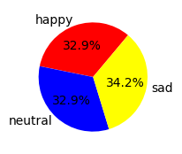
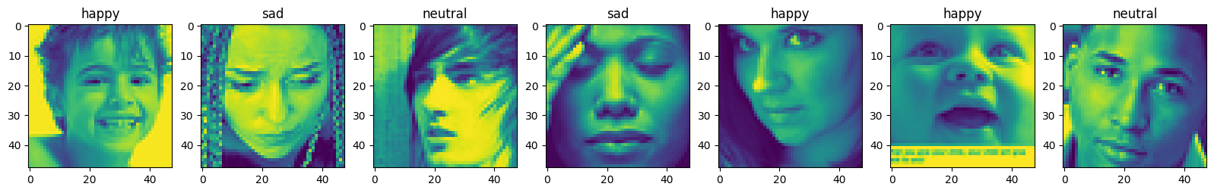
METHEDOLOGY
1.DATA COLLECTION
Several datasets are accessible in the literature for human emotion detection using images such as CK+ (Cohn-Kanade) dataset, Kaggle and so on. We’ve used dataset available in Kaggle.Image data analysis is a powerful tool for extracting insights and information from images, with applications in fields ranging from computer vision to scientific research. The image dataset is divided into two categories: training and testing .This dataset has 5000 images divided into three classes happy, neutral and sad.
2. IMAGE PREPROCESSING
ImageDataGenerator utility class present in Keras is used for image preprocessing. Rescale parameter rescales the pixel value of images. ‘rescale’ parameter rescales the pixel values of the images. Dividing by 255 ensures that the pixel values are normalized between 0 and 1, which is a common preprocessing step in image analysis. ‘shear_range’ parameter randomly applies shearing transformations to the images. Shearing involves shifting the positions of pixels in a certain direction, which can introduce variations in image shape and appearance.‘zoom_range’ parameter randomly applies zooming transformations to the images. Zooming involves magnifying or shrinking parts of the image, which can simulate different perspectives or levels of detail. ‘horizontal_flip’ parameter randomly flips the images horizontally. This augmentation technique helps create variations in the dataset and can improve the model's ability to generalize by considering images from different viewpoints.

Slide 7
3. Proposed Architecture
The proposed architecture aims to leverage the power of deep neural networks to effectively detect human emotions from images. It consists of 8 convolutional layers, 2 hidden layers, and 1 output layer. Dropout regularization with a rate of 0.2 is applied in the convolutional layers and the output layer to prevent overfitting.
Architecture overview:
Input Layer: The input layer receives the input images, which are typically grayscale or color images representing human faces. The size of the input layer is determined by the dimensions of the input images.
Convolutional Layers: The architecture includes 8 convolutional layers, each followed by a Rectified Linear Unit (ReLU) activation function to introduce non-linearity. The number of filters and kernel size can be adjusted based on the complexity of the dataset and the computational resources available. Dropout with a rate of 0.2 is applied after each convolutional layer to regularize the model and prevent overfitting.
Pooling Layers: After each convolutional layer, a pooling layer is introduced to reduce the spatial dimensions and extract the most salient features. Max pooling is commonly used to capture the most important information within each pooling region.
Hidden Layers: Following the convolutional layers, 2 fully connected hidden layers are introduced. These layers allow the model to learn higher-level representations and capture complex relationships between the extracted features. The number of nodes or neurons in each hidden layer can be adjusted based on the complexity of the problem and the available computational resources. Activation functions like ReLU can be applied to introduce non-linearity.
Output Layer: The output layer represents the final layer of the neural network and provides the classification results for different emotional states. The number of nodes in the output layer corresponds to the number of distinct emotions to be detected. A suitable activation function, such as SoftMax, is used to produce probability distributions over the emotions, indicating the likelihood of each emotional state.
Dropout in Convolutional Layers and Output Layer: Dropout regularization with a rate of 0.2 is applied after each convolutional layer and the output layer. Dropout randomly deactivates a fraction of the neurons during training, reducing overfitting by promoting robustness and preventing reliance on specific features.
The proposed architecture aims to capture and learn both low-level and high-level features in human facial expressions, enabling accurate emotion detection. It provides flexibility in terms of adjusting the number of filters, kernel sizes, hidden layers, and output layer nodes based on the complexity of the emotion detection task and the available computational resources. The inclusion of dropout regularization helps improve the model's generalization ability and prevents overfitting.

Slide 8
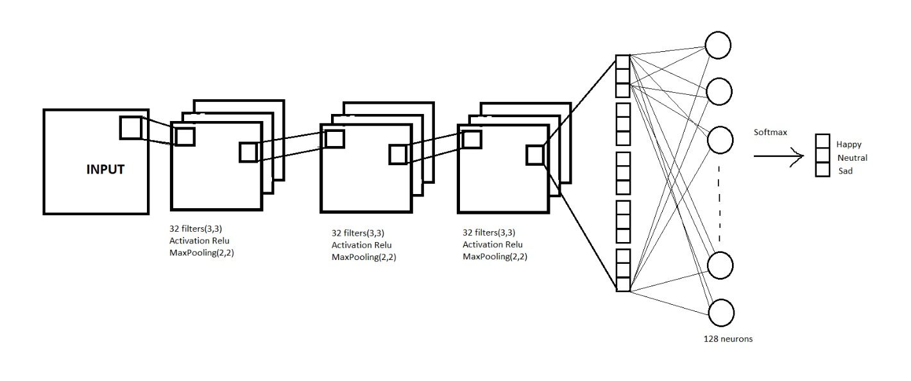
ARCHITERCTURE
Fig1.CNN architecture without dropouts

Slide 9
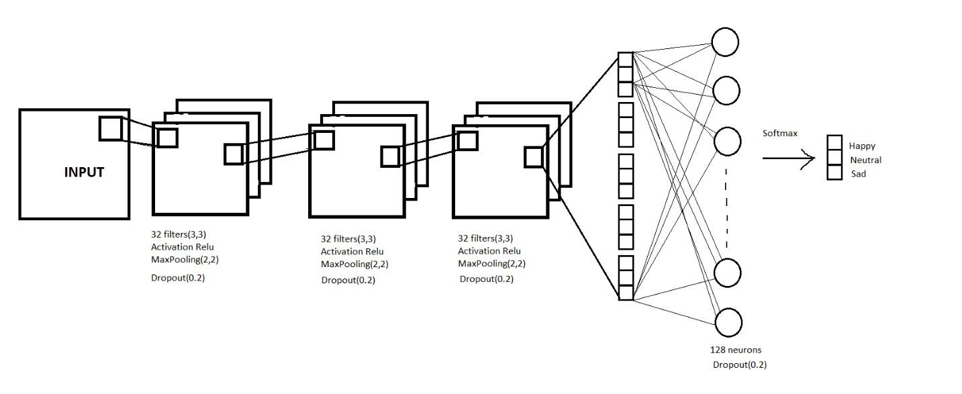
Fig2.CNN architecture with dropouts

Slide 10
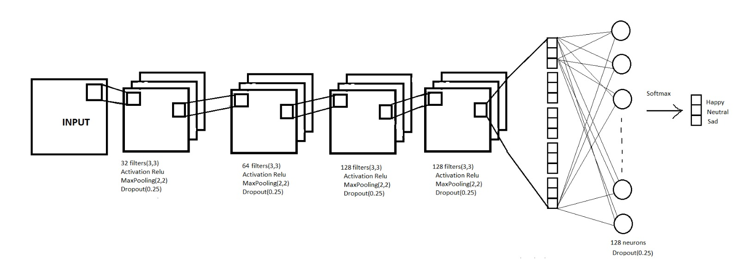
Customised Architecture using Adam Optimiser
z
Fig3.Customised CNN Architecture

Slide 11
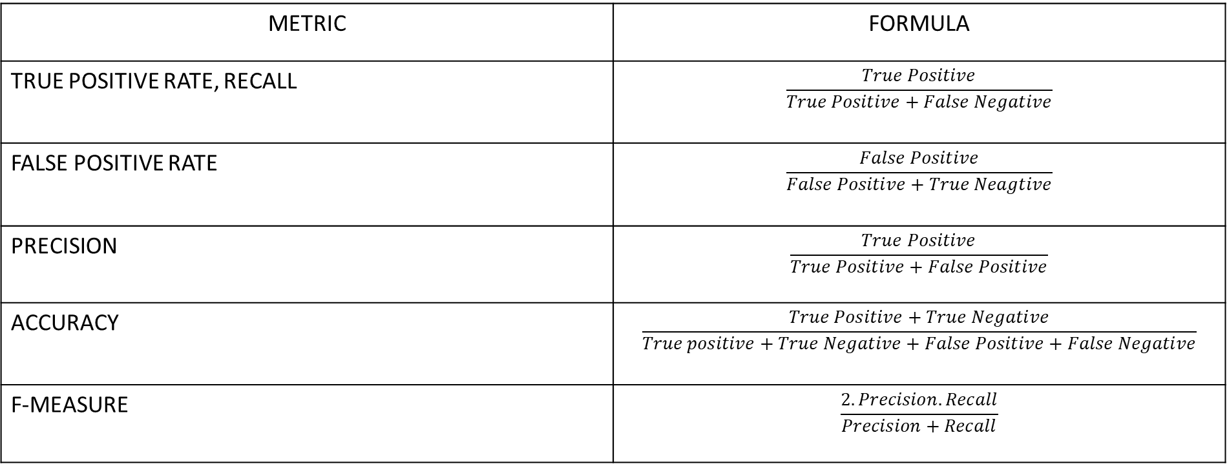
RESULT
1.EVALUATION METRICS
METRIC | FORMULA
TRUE POSITIVE RATE, RECALL | $$\frac{True Positive}{True Positive+False Negative}$$
FALSE POSITIVE RATE | $$\frac{False Positive}{False Positive+True Neagtive}$$
PRECISION | $$\frac{True Positive}{True Positive+False Positive}$$
ACCURACY | $$\frac{True Positive+True Negative}{True positive+True Negative+False Positive+False Negative}$$
F-MEASURE | $$\frac{2.Precision.Recall}{Precision+Recall}$$

Slide 12
Test Accuracy = (Number of Correctly Classified Samples) / (Total Number of Samples) Test Loss = (1 / N) * ∑ L(ŷ_i, y_i) Where:
N is the total number of test samples ŷ_i is the predicted label for the i-th test sample y_i is the true label for the i-th test sample L(ŷ_i, y_i) is the loss function applied to the predicted and true labels for the i-th test sample

Slide 13
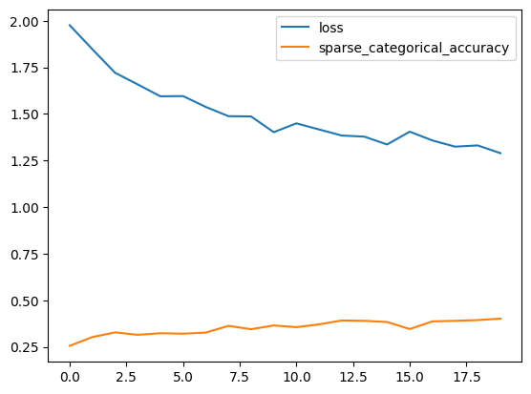
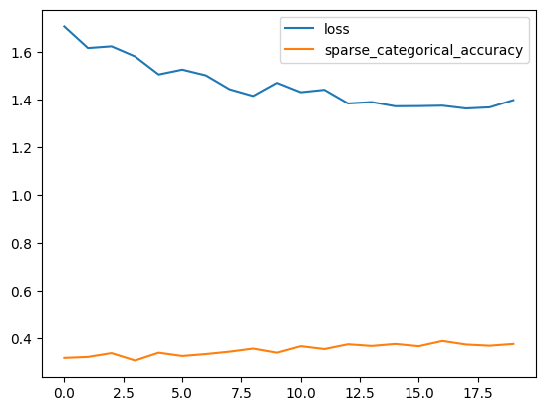
2.MODEL’S PERFORMACE WITH DIFFERENT OPTIMZERS
2.1 SGD
WITHOUT DROPOUTS | WITH DROPOUTS
Training accuracy | 0.4018
Testing accuracy | 0.3695
Training Loss | 1.2894
Testing Loss | 1.3568470
Training accuracy | 0.3754
Testing accuracy | 0.32
Training Loss | 1.3990
Testing Loss | 1.45

Slide 14
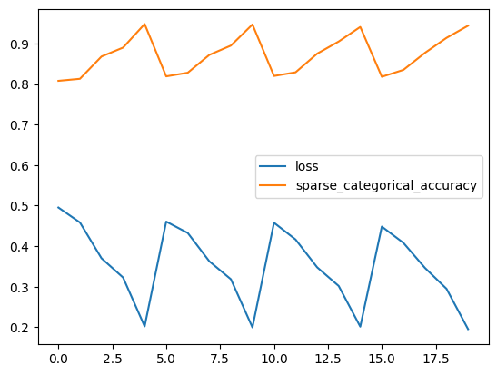
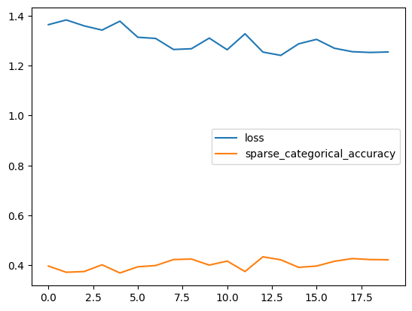
2.2 ADAGRAD
WITHOUT DROPOUTS | WITH DROPOUTS
Training accuracy | 0.9440
Testing accuracy | 0.78
Training Loss | 0.1953
Testing Loss | 0.5622
Training accuracy | 0.422
Testing accuracy | 0.39
Training Loss | 1.25349
Testing Loss | 1.32

Slide 15
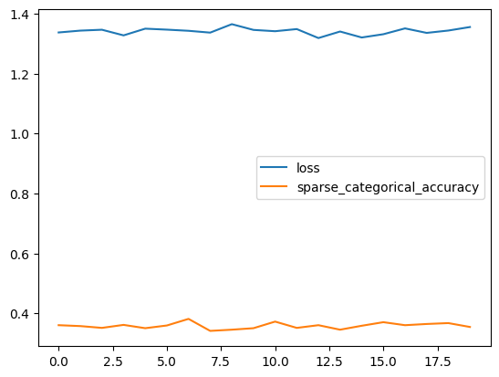
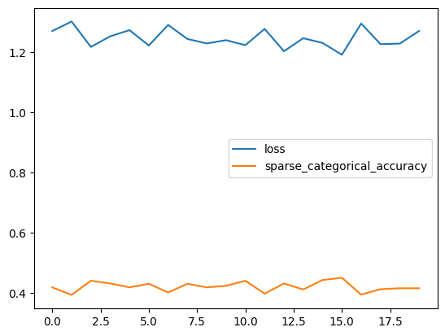
2.3 ADADELTA
WITHOUT DROPOUTS | WITH DROPOUTS
Training accuracy | 0.3656
Testing accuracy | 0.3550
Training Loss | 1.3553
Testing Loss | 1.3352
Training accuracy | 0.4151
Testing accuracy | 0.37
Training Loss | 1.2698
Testing Loss | 1.45

Slide 16
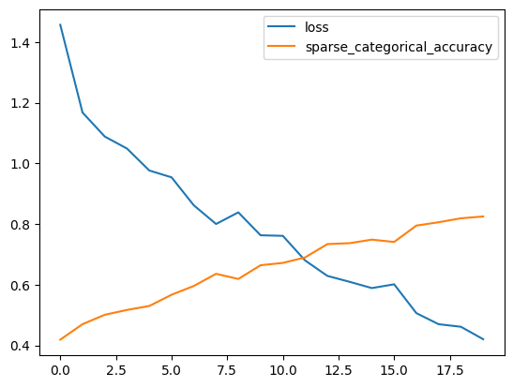
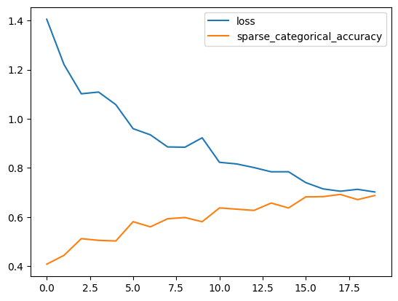
2.4 RMSPROP
WITHOUT DROPOUTS | WITH DROPOUTS
Training accuracy | 0.8250
Testing accuracy | 0.7365
Training Loss | 0.4205
Testing Loss | 0.6492
Training accuracy | 0.687
Testing accuracy | 0.4123
Training Loss | 0.7019
Testing Loss | 0.876

Slide 17
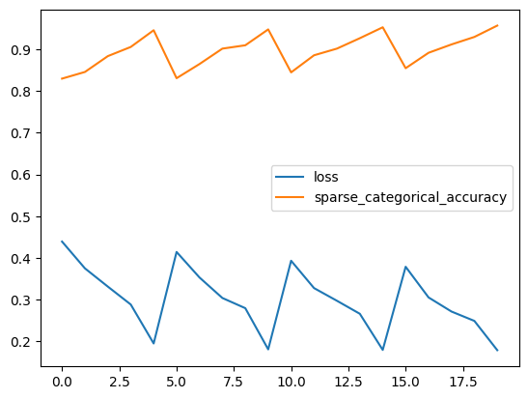
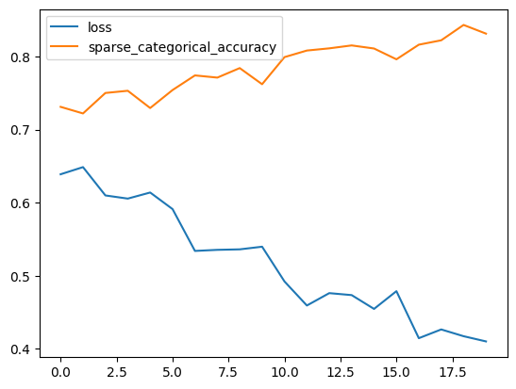
2.5 SGD(MOMENTUM)
WITHOUT DROPOUTS | WITH DROPOUTS
Training accuracy | 0.9573
Testing accuracy | 0.7968
Training Loss | 0.1784
Testing Loss | 0.5488
Training accuracy | 0.8311
Testing accuracy | 0.79
Training Loss | 0.4103
Testing Loss | 0.45

Slide 18
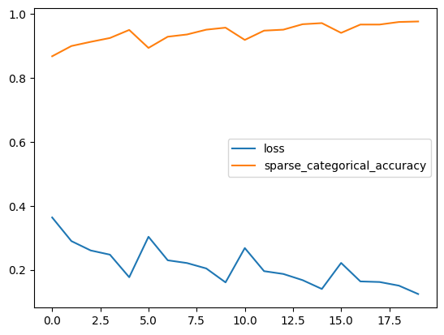
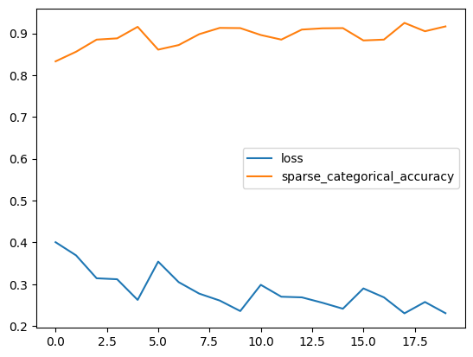
2.6 ADAM
WITHOUT DROPOUTS | WITH DROPOUTS
Training accuracy | 0.9756
Testing accuracy | 0.84
Training Loss | 0.1245
Testing Loss | 0.42
Training accuracy | 0.9166
Testing accuracy | 0.8348
Training Loss | 0.2305
Testing Loss | 0.472

Slide 19
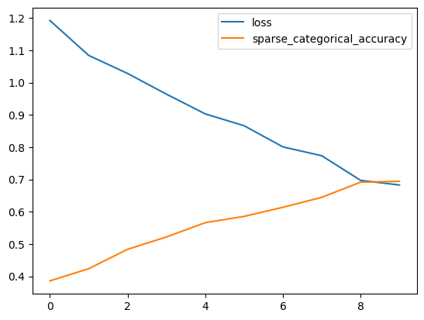
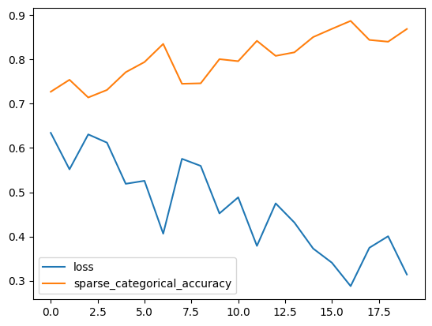
ALEXNET
WITHOUT DROPOUTS | WITH DROPOUTS
Training accuracy | 0.6943
Testing accuracy | 0.52
Training Loss | 0.6828
Testing Loss | 0.691
Training accuracy | 0.8688
Testing accuracy | 0.8361
Training Loss | 0.3141
Testing Loss | 0.4811

Slide 20
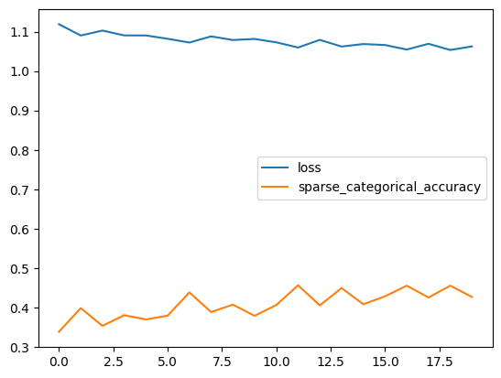
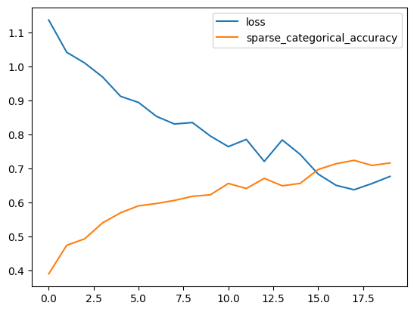
RESNET
WITHOUT DROPOUTS | WITH DROPOUTS
Training accuracy | 0.4262
Testing accuracy | 0.23
Training Loss | 1.0626
Testing Loss | 1.281
Training accuracy | 0.7162
Testing accuracy | 0.29
Training Loss | 0.6767
Testing Loss | 0.712

Slide 21
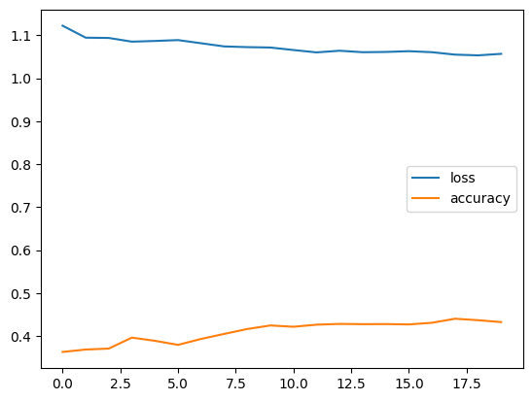
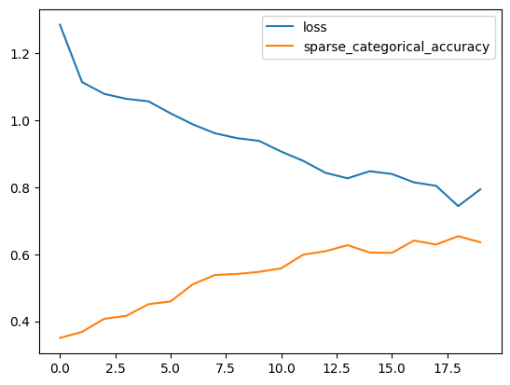
VGG16
WITHOUT DROPOUTS | WITH DROPOUTS
Training accuracy | 0.5007
Testing accuracy | 0.3630
Training Loss | 1.0249
Testing Loss | 1.355
Training accuracy | 0.635
Testing accuracy | 0.3879
Training Loss | 0.7939
Testing Loss | 1.342

Slide 22
OPTIMIZERS
WITHOUT DROPOUTS | WITH DROPOUTS
TRAINING ACCURACY | TRAINING LOSS | TESTING ACCURACY | TESTING LOSS
Training Accuracy | Training Loss | Testing Accuracy | Testing Loss
SGD | 0.4018 | 1.2894 | 0.3695 | 1.3568 | 0.3754 | 1.3990 | 0.32 | 1.45
ADADELTA | 0.3656 | 1.3553 | 0.3550 | 1.42 | 0.4151 | 1.2698 | 0.37 | 1.45
ADAGRAD | 0.9440 | 0.1953 | 0.78 | 0.5622 | 0.422 | 1.253 | 0.39 | 1.32
ADAM | 0.9756 | 0.1245 | 0.84 | 0.16 | 0.982 | 0.18 | 0.85 | 0.15
RMSPROP | 0.8250 | 0.4205 | 0.7365 | 0.6492 | 0.687 | 0.7019 | 0.4123 | 0.876
SGD(MOMENTUM) | 0.9573 | 0.1784 | 0.7968 | 0.5488 | 0.8311 | 0.4103 | 0.79 | 0.45
ALEXNET | 0.6943 | 0.6828 | 0.52 | 0.691 | 0.8688 | 0.3141 | 0.8361 | 0.4811
RESNET | 0.4262 | 1.0626 | 0.23 | 1.28 | 0.7162 | 0.6767 | 0.29 | 0.712
VGG16 | 0.5007 | 1.0249 | 0.3630 | 1.355 | 0.635 | 0.7939 | 0.3879 | 1.342

Slide 23
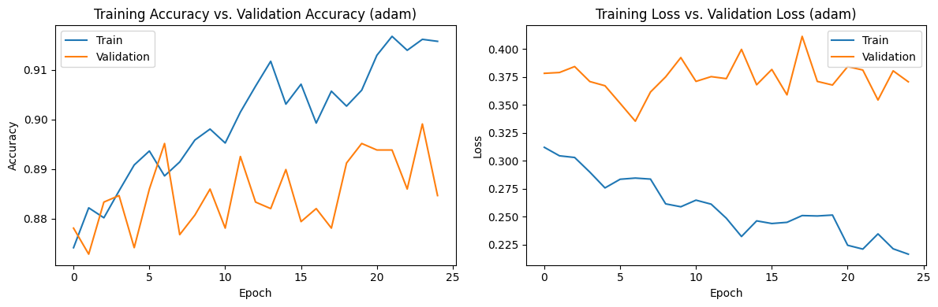
Result from customised CNN model
Training accuracy | 0.8923
Testing accuracy | 0.867
Training Loss | 0.32
Testing Loss | 0.4

Slide 24
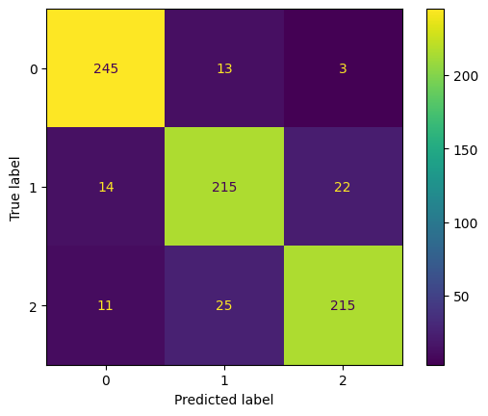
Confusion matrix of customised architecture

Slide 25
Conclusion
Human emotion detection using Convolutional Neural Networks (CNNs) has emerged as a significant area of research with various applications in psychology, human-computer interaction, and affective computing. This architecture is a proposed approach for human emotion detection by applying CNNs with multiple optimizers.
The study demonstrated the effectiveness of CNNs in automatically extracting discriminative features from images and mapping them to specific emotional states.
By leveraging the power of CNNs, the proposed method achieved promising results in accurately detecting and classifying human emotions.
Furthermore we explored the impact of multiple optimizers, including Stochastic Gradient Descent (SGD), Adam, RMSprop, and Adagrad, on the performance of the emotion detection model.
The experimental results highlighted the influence of optimizer selection on convergence speed and overall accuracy. Certain optimizers demonstrated superior performance, indicating their effectiveness in training CNN models for human emotion detection tasks.
The choice of dataset, such as the CK+, Kaggle datasets, played a vital role in training and evaluating the emotion detection model.
The Kaggle dataset provided a diverse range of facial expressions, enabling the model to learn and generalize well to different emotional states. The availability of annotated emotion labels and facial landmarks in the dataset facilitated supervised learning and accurate feature extraction.
The findings of this study contribute to the advancement of human emotion detection techniques using CNNs. The insights gained from the experiments and analysis provide valuable guidance for researchers and practitioners working in the field of computer vision and affective computing.
Future research directions may involve exploring more advanced CNN architectures, incorporating multimodal information (such as audio or text) for improved emotion detection, and investigating the transferability of pre-trained models on large-scale datasets. Additionally, the deployment of emotion detection models in real-world applications, such as emotion-aware systems or human-robot interaction, can be further explored and optimized.
Overall, it holds great potential for understanding and interpreting human affective states. By continuously refining and advancing these techniques, we can unlock new opportunities for enhancing human-machine interactions and improving various aspects of human well-being.

